Slide 1
P4: Refactoring and Internal Design
Hnefatafl
Cookie Byte
Torry Brelsford, Mauricio Munoz, Timothy Chessin, Connor Shilling, Ben Baranovsky

Slide 2
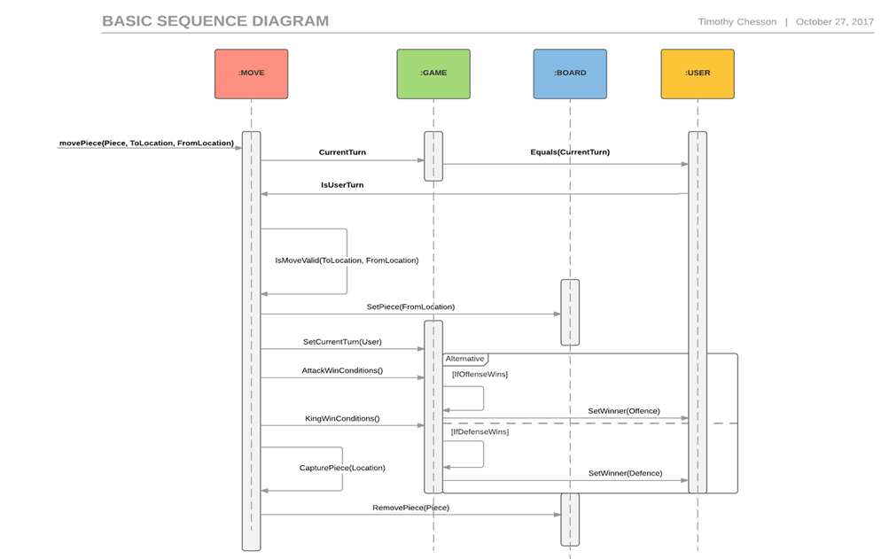
Sequence Diagram: Make Move Before

Slide 3
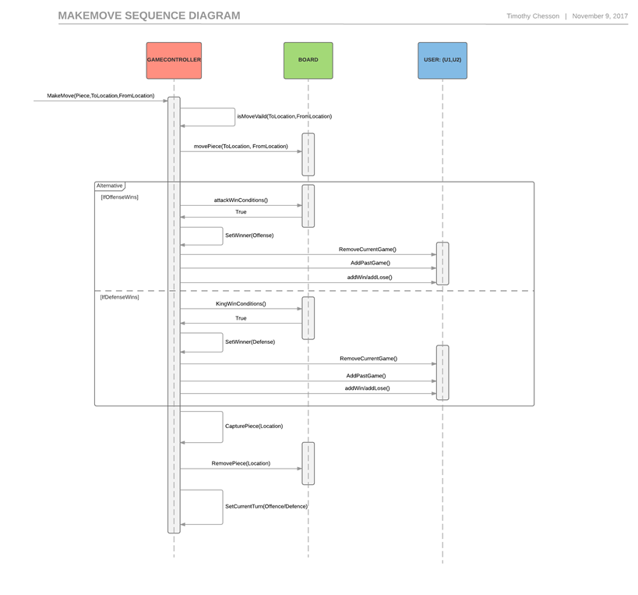
Sequence Diagram: Make Move After

Slide 4
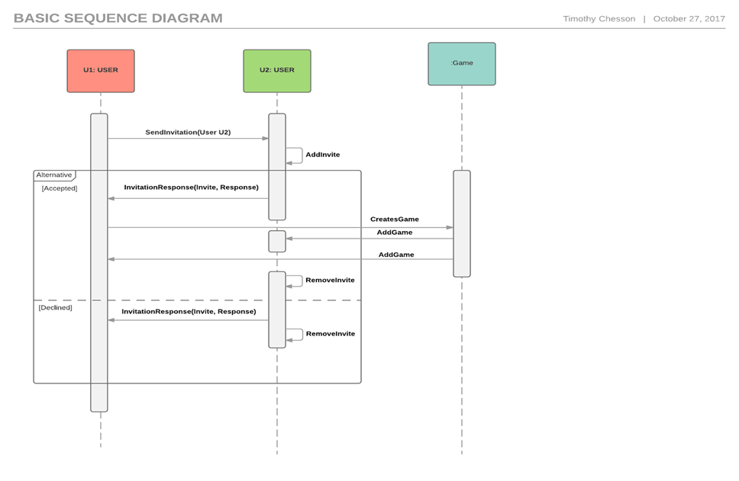
Sequence Diagram: Invites Before

Slide 5
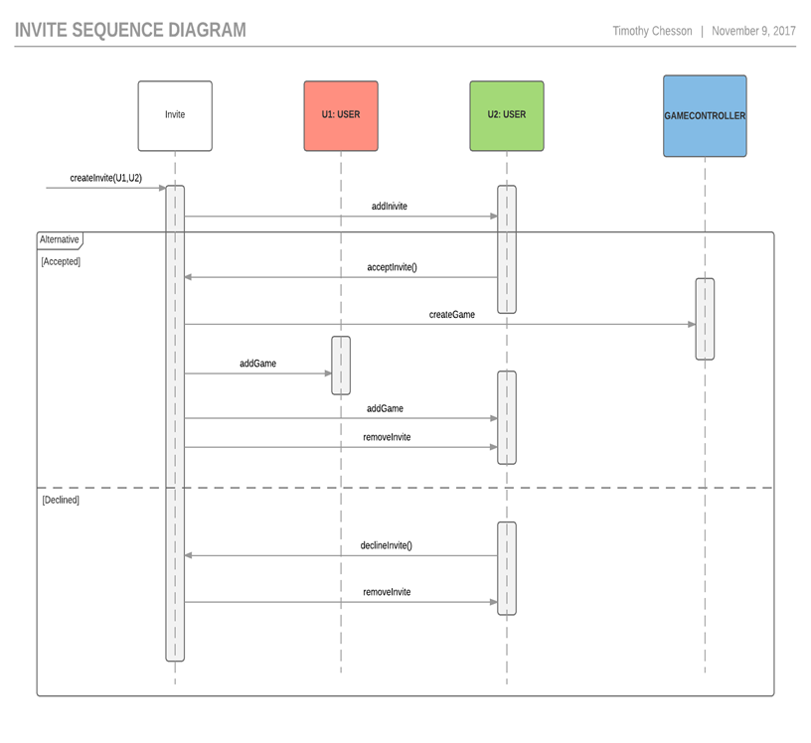
Sequence Diagram: Invites After

Slide 6
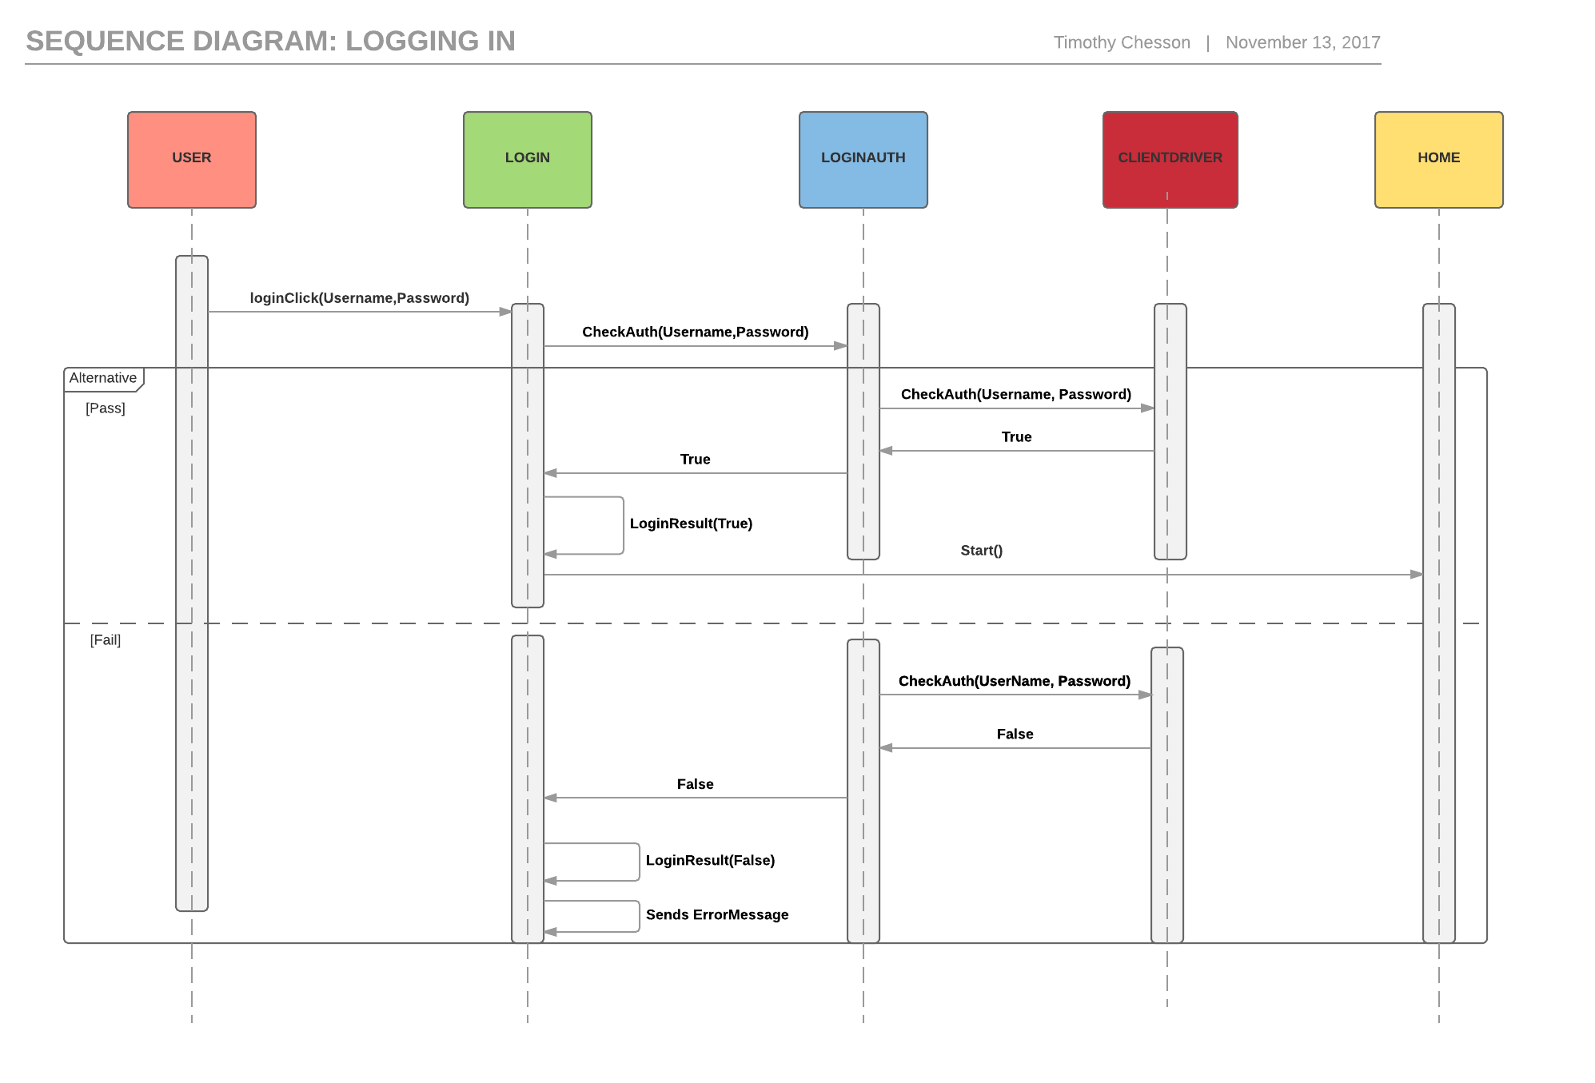
New Login Sequence Diagram

Slide 7
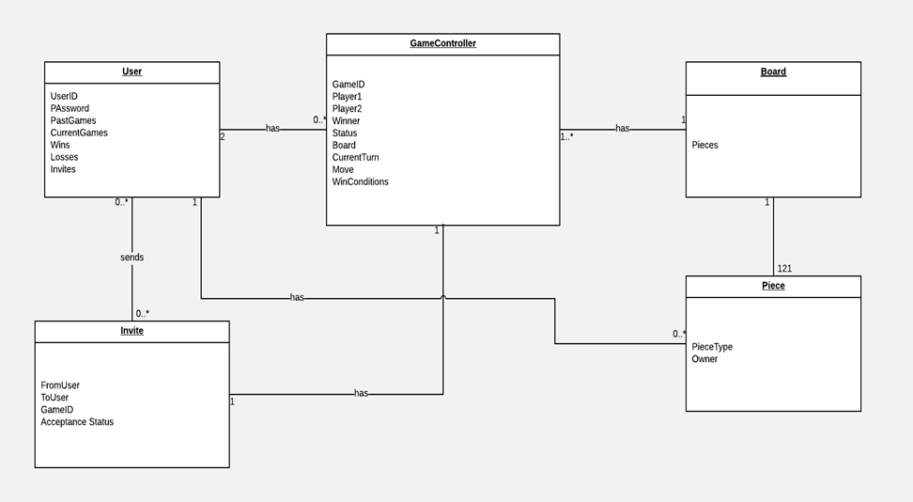
New Domain Model

Slide 8
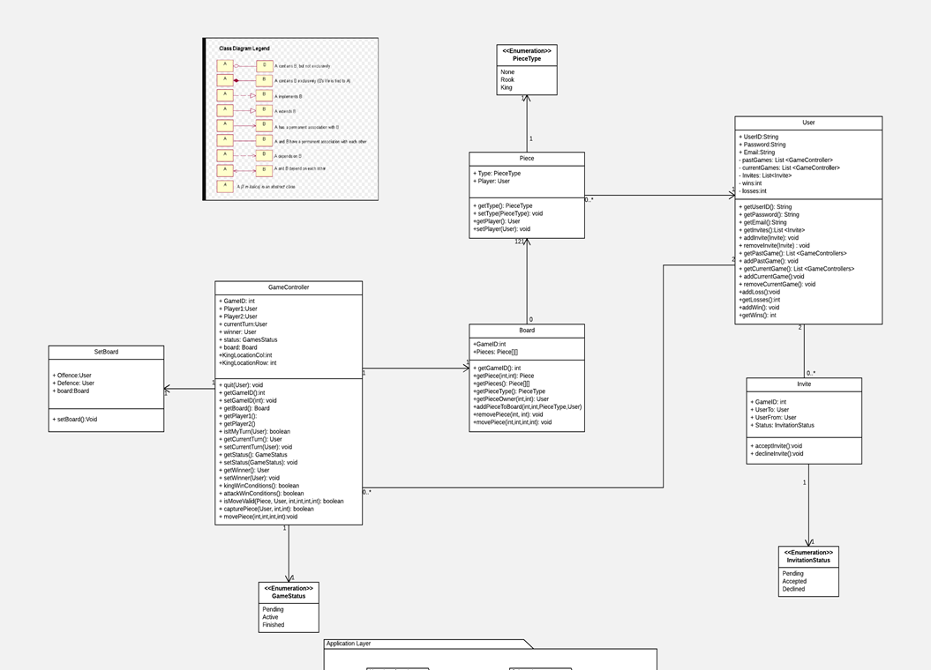
New Class Design Diagram

Slide 9
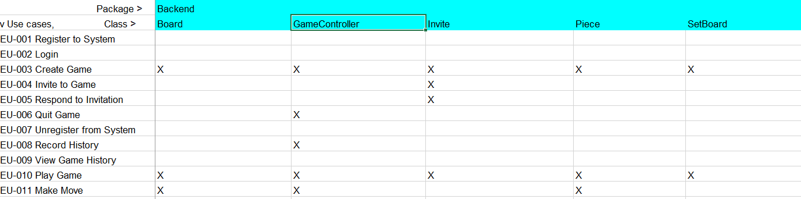
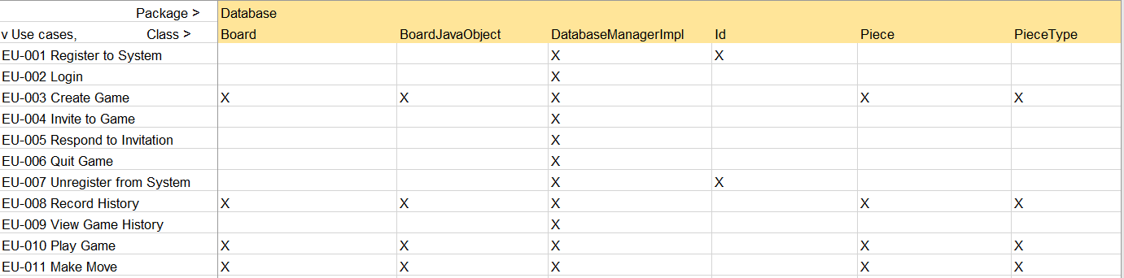
Traceability Matrix
Backend:
Database:

Slide 10
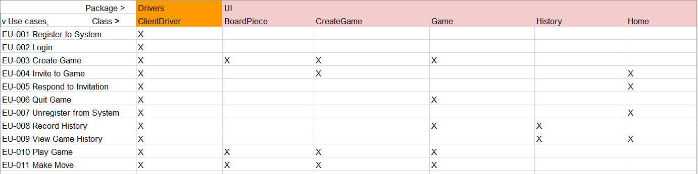
Traceability Matrix
User Interface:

Slide 11
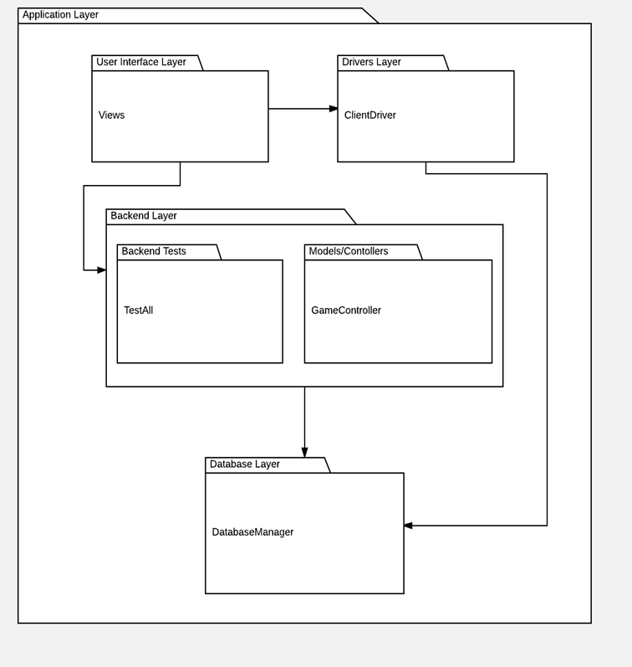
Package Diagram

Slide 12
Refactoring List
Coupler smell: Inappropriate Intimacy - GameController used all MakeMove methods.
- Solution: Move all MakeMove methods into GameController and remove MakeMove class.
Coupler smell: Middle Man- GameDriver was acting as middleman between GameController and the UI.
-Solution: Remove GameDriver and have a direct connection between GameController and UI
Coupler smell: Middle Man- Space was acting as a middleman between Piece and Board.
-Solution: Remove Space and board consist of different type of Pieces including Rook, King, or None.
Dispensable smell: Dead Code - UniqueRandomNumbers was created with the intent to generate unique IDs, but database handles the creation of IDs.
-Solution: Remove UniqueRandomNumbers
Dispensable smell: Dead Code – DatabaseDriver was created to facilitate communication between database and code, but was never used.
-Solution: Remove DatabaseDriver

Slide 13
Refactoring List
Design Patterns:
o Controller Pattern:
- Problem: Who should be responsible for handling an input system event?
- Solution: GameContoller defines all the methods for all system operations. It’s this class that’s responsible for receiving and handling system events made by the user via the GUI. It also receives signals from different sensors or triggers from the UI to maintain/control information about the state of the game.
o Observers Pattern:
-Problem- If one object changes its state how will all classes that are dependent on that object be notified and updated automatically?
-Soultion- Our whole entire UI Package is a view that contains and represents the observers needed to make a MVC pattern work. In our game this usually comes in the form of buttons that handle event management. For example when player hits “Refresh” the game object and all information pertaining to it (i.e board) is updated.
Coupler smell: Inappropriate Intimacy - GameController used all MakeMove methods. - Solution: Move all MakeMove metods into GameController and remove MakeMove class. Coupler smell: Middle Man- GameDriver was acting as middle man between GameController and the UI. Solution: Remove GameDriver and have a direct connection between GameController and UI o Coupler smell: Middle Man- Space was acting as a middle man between Piece and Board. | Solution: Remove Space and board consist of different type of Pieces including Rook, King, or None. o Dispensable smell: Dead Code - UniqueRandomNumbers was created with the intent to generate unique IDs, but database handles the creation of IDs. Solution: Remove UniqueRandomNumbers o Dispensable smell: Dead Code – DatabaseDriver was created to facilitate communication between database and code, but was never used. Solution: Remove DatabaseDriver

Slide 14
What we have working well. | What we still need to finalize.
User Sign-in and Authentication. User Profile and play history can be viewed. All Moves can be made within a game and saved in Database. Users can Logout and Unregister. Invites and Current Games can be Viewed. Current Turn within Game/Database is updated and Pieces are now highlighted. Two registered Users can play a game at the same time using refresh and finish it. | Tournament Feature. User profile Look-up/Search. Auto-Refresh. More User Messages/Prompts to help guide User through interface. Syncing a Finished or Quitted game in Database to update history. Sending Invites/Syncing Invites in Database. Adjust J-Unit Testing to new Changes.
Notes:
so you leave login or?
Should I?

Slide 15
Let’s Demo

Slide 16
We will now accept compliments

